Slide 1






Enhanced environmental protection inspection for efficient control of air quality monitoring and of all entities under obligation within system of greenhouse gas emission allowance trading, in order to achieve better quality of air in Republic of Croatia
This project is funded by the European Union

Slide 2



TOPIC 11: Inspection monitoring
Energy research and Environmental Protection Institute

Slide 3

11.7 CAA’s role in planning and implementation of inspection
European Union IPA 2013 Programme for Croatia
CROATIAN ACCREDITATION AGENCY
Accreditation is a measure of establishing trust in the product and service market, as it means an independent and impartial assessment of the qualifications of bodies that perform calibration, testing, certification of products, processes and services, management systems, staff, inspection, organization of capacity testing, verification of greenhouse gas emissions and verification in the EMAS system.
Accreditation activities in the Republic of Croatia are carried out by the Croatian Accreditation Agency (CAA).
The Croatian Accreditation Agency is a public non-profit institution operating under the Accreditation Act (Official Gazette No. 158/03 and Official Gazette No. 75/09, 56/13).
Institut za energetiku i zaštitu okoliša
Energy Research and Environmental Protection Institute

Slide 4
11.7 CAA’s role in planning and implementation of inspection
European Union IPA 2013 Programme for Croatia
CROATIAN ACCREDITATION AGENCY
The CAA was established for the implementation of Croatian technical legislation, which is in line with the acquis communautaire of the EU. Technical regulations regulate product safety and freedom of movement in the internal market, the protection of citizens' health, consumer protection, environmental protection and other areas of public interest.
The CAA is an independent, non-profit and non-commercial national accreditation institution and meets all international and European standards for accreditation bodies and is accepted in the Republic of Croatia as the Croatian standard HRN EN ISO / IEC 17011: 2005 and the requirements of Regulation (EC) No. 765/2008 of the European Parliament and of the Council of 9 July 2008 on the establishment of applications for the accreditation and supervision of markets in respect of product placing on the market.
Institut za energetiku i zaštitu okoliša
Energy Research and Environmental Protection Institute

Slide 5
11.7 CAA’s role in planning and implementation of inspection
European Union IPA 2013 Programme for Croatia
CROATIAN ACCREDITATION AGENCY
The CAA represents the Republic of Croatia in European and international accreditation organizations and participates in their work.
The CAA is a full member of EA and a signatory of EA MLA (European Accreditation Cooperation).
The CAA is a full member of ILAC and a signatory of ILAC MRA (International Organization for Laboratory Accreditation).
The CAA signed the Multilateral Agreement on recognition of accreditation equality with EA - EA MLA - for 6 Accreditation Schemes of 29 April 2010 and for the accreditation area of greenhouse gases verifiers on 3 October 2014 and with ILAC (ILAC MRA) it signed the Agreement on Mutual Recognition of Laboratory Accreditation on April 29, 2010 and for the inspection area in 2012.
Institut za energetiku i zaštitu okoliša
Energy Research and Environmental Protection Institute

Slide 6
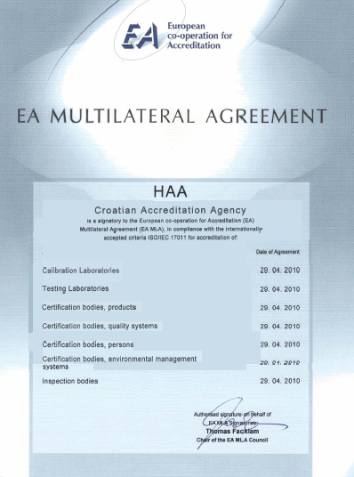
11.7 CAA’s role in planning and implementation of inspection
European Union IPA 2013 Programme for Croatia
Institut za energetiku i zaštitu okoliša
Energy Research and Environmental Protection Institute

Slide 7
11.7 CAA’s role in planning and implementation of inspection
European Union IPA 2013 Programme for Croatia
CROATIAN ACCREDITATION AGENCY
The conformity assessment of products, processes and services with technical regulations and standards is carried out by professionally and technically trained laboratories, certification bodies, inspection bodies and other bodies.
The internationally accredited way of demonstrating qualification for assessment is accreditation.
Accredited bodies trust the services of testing, certification, inspection, calibration, capability testing, verification regardless whether it is a legally regulated area or in a voluntary field.
Institut za energetiku i zaštitu okoliša
Energy Research and Environmental Protection Institute

Slide 8
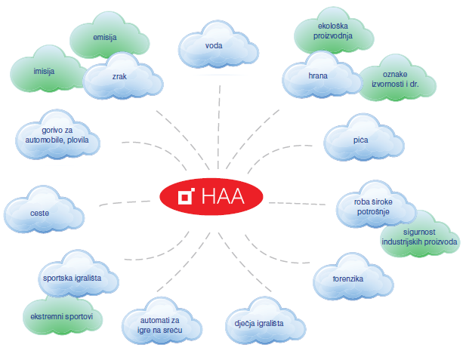
11.7 CAA’s role in planning and implementation of inspection
European Union IPA 2013 Programme for Croatia
CAA accreditation is used in various branches of the economy, environmental protection, health protection and consumer protection.
Institut za energetiku i zaštitu okoliša
Energy Research and Environmental Protection Institute

Slide 9
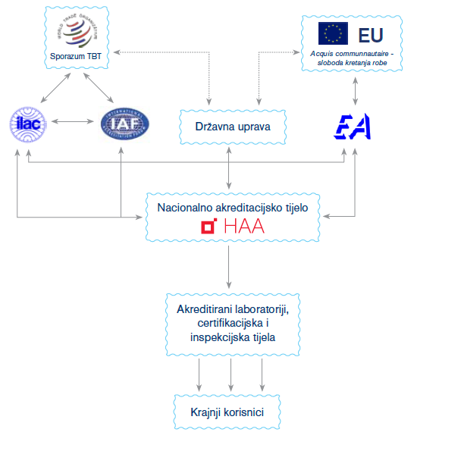
11.7 CAA’s role in planning and implementation of inspection
European Union IPA 2013 Programme for Croatia
CAA’s role in international exchange of goods and services
Institut za energetiku i zaštitu okoliša
Energy Research and Environmental Protection Institute

Slide 10
11.7 CAA’s role in planning and implementation of inspection
European Union IPA 2013 Programme for Croatia
CROATIAN ACCREDITATION AGENCY
The CAA performs accreditation and accreditation maintenance procedures
determined by the following national, European and international norms and normative documents:
Scheme | Criteria
Testing laboratories | HRN EN ISO/IEC 17025
Calibration laboratories | HRN EN ISO/IEC 17025
Medical laboratories | HRN EN ISO 15189
Certification bodies for products | HRN EN ISO/IEC 17065
Certification bodies for management systems | HRN EN ISO/IEC 17021-1
Certification bodies for staff | HRN EN ISO/IEC 17024
Inspection bodies | HRN EN ISO/IEC 17020
Institut za energetiku i zaštitu okoliša
Energy Research and Environmental Protection Institute

Slide 11
11.7 CAA’s role in planning and implementation of inspection
European Union IPA 2013 Programme for Croatia
CROATIAN ACCREDITATION AGENCY
Scheme | Criteria
Organizers of Capability Testing | HRN EN ISO/IEC 17043
Verifiers of greenhouse gas emissions | HRN EN ISO 14065 Regulation EC/600/2012 Regulation EC //2016/2072 Regulation EC //2015/757
EMAS verifiers | HRN EN ISO/IEC 17021-1 Regulation (EC) 1221/2009
Institut za energetiku i zaštitu okoliša
Energy Research and Environmental Protection Institute

Slide 12
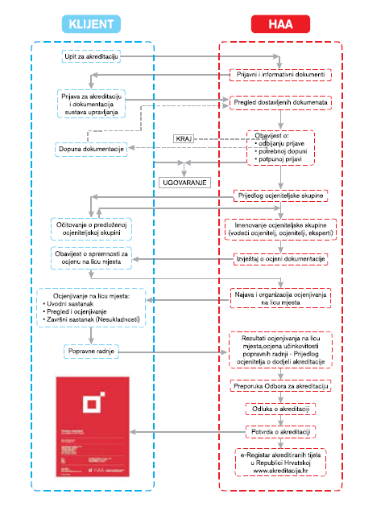
11.7 CAA’s role in planning and implementation of inspection
European Union IPA 2013 Programme for Croatia
ACCREDITATION
PROCEDURE
Institut za energetiku i zaštitu okoliša
Energy Research and Environmental Protection Institute

Slide 13
11.7 CAA’s role in planning and implementation of inspection
European Union IPA 2013 Programme for Croatia
PRE-APPLICATION ACTIVITIES
An organization interested in obtaining accreditation by a national accreditation body, which is represented in the Republic of Croatia by the CAA, should send a request to the agency about the scheme and the area in which it is interested.
REQUEST can be submitted:
via the CAA website (http://www.akreditacija.hr/eupit)
via e-mail
by telephone
a personal visit to CAA
No later than one week after the receipt of the request and no matter how the request submission is made, the CAA will evaluate it and submit the application and information documents to the party.
Institut za energetiku i zaštitu okoliša
Energy Research and Environmental Protection Institute

Slide 14
11.7 CAA’s role in planning and implementation of inspection
European Union IPA 2013 Programme for Croatia
ACCREDITATION APPLICATION
As a rule, an accreditation application is submitted when a party can provide evidence that it has a documented, implemented and maintained management system based on the relevant standard and other accompanying documents, which means that it is prepared for evaluation.
The organization interested in accreditation submits the application documents to the CAA.
The CAA initiates the accreditation procedure and contracting with the party after the application documents are complete and valid.
Institut za energetiku i zaštitu okoliša
Energy Research and Environmental Protection Institute

Slide 15
11.7 CAA’s role in planning and implementation of inspection
European Union IPA 2013 Programme for Croatia
EVALUATION
After the CAA determines that the application is complete and valid, the accreditation process is initiated, which in the first step after contracting requires the selection of an evaluation team.
The evalouation team that conducts the evaluation consists of a lead evaluator and one or more evaluators and / or experts. The number of evaluators depends on the scope of the area applied for accreditation.
All members of the evaluation team, including experts and trainee evaluators, are required to meet the requirements of impartiality, independence and confidentiality of confidential documents and data.
Institut za energetiku i zaštitu okoliša
Energy Research and Environmental Protection Institute

Slide 16
11.7 CAA’s role in planning and implementation of inspection
European Union IPA 2013 Programme for Croatia
EVALUATION
DOCUMENTATION EVALUATION
The documentation evaluation of the organization management system shall specify the conformity of documents and records with the requirements of the relevant standard and with the regulations and rules relating to the accreditation process.
Further accreditation procedure runs after elimination of non-compliances established during the documentation evaluation.
Only when the entire documentation complies with the relevant criteria (e.g. Laboratory Documentation according to HRN EN ISO / IEC 17025) the evaluation shall commence on site.
Institut za energetiku i zaštitu okoliša
Energy Research and Environmental Protection Institute

Slide 17
11.7 CAA’s role in planning and implementation of inspection
European Union IPA 2013 Programme for Croatia
EVALUATION
ON-SITE EVALUATION
On-site evaluation is a key part of the accreditation process.
The assessment is carried out in the manner defined by the standard HRN EN ISO 19011, and consists of three basic phases:
- an introductory meeting,
- review and evaluation,
- final meeting.
At the introductory meeting, before the start of the review and evaluation, the evaluators and representatives of the applicant confirm, inter alia, the evaluation plan and the final assessment area that can no longer be changed afterwards.
Institut za energetiku i zaštitu okoliša
Energy Research and Environmental Protection Institute

Slide 18
11.7 CAA’s role in planning and implementation of inspection
European Union IPA 2013 Programme for Croatia
EVALUATION
ON-SITE EVALUATION
The review and assessment cover various evaluation methods and techniques by which the CAA evaluation group collects information on an organization's qualifications according to the relevant criterion (e.g. HRN EN ISO / IEC 17025) in a defined area of accreditation (e.g. Air Quality Test by standard test methods).
The final meeting is the final step of the on-site evaluation where a group of evaluators notifies the applicants' representatives on the results of the evaluation carried out (the recommendation what is accepted in the accreditation, subject to the elimination of the noncompliances that have been established during the review).
Institut za energetiku i zaštitu okoliša
Energy Research and Environmental Protection Institute

Slide 19
11.7 CAA’s role in planning and implementation of inspection
European Union IPA 2013 Programme for Croatia
EVALUATION
DECISION ON ACCREDITATION
Once all the deficiencies have been removed and the evaluation group has agreed on the final accreditation area of an organization, all accreditation reports and records are submitted to the Accreditation Committee which reviews the entire accreditation process.
The Accreditation Board makes the final recommendation regarding accreditation.
Based on the recommendations of the Accreditation Board, the CAA Director makes a decision on accreditation.
ACCREDITATION CERTIFICATE is issued after the positive decision on the accreditation.
Institut za energetiku i zaštitu okoliša
Energy Research and Environmental Protection Institute

Slide 20
11.7 CAA’s role in planning and implementation of inspection
European Union IPA 2013 Programme for Croatia
ACCREDITATION
A certificate of accreditation is a public document.
After obtaining the accreditation certificate, the organization that has acquired it can refer to the status of accreditation – by a statement or accreditation symbol.
The Accreditation Register is publicly available at http://www.akreditacija.hr/registar
It can be searched for status information and accreditation area.
Institut za energetiku i zaštitu okoliša
Energy Research and Environmental Protection Institute

Slide 21
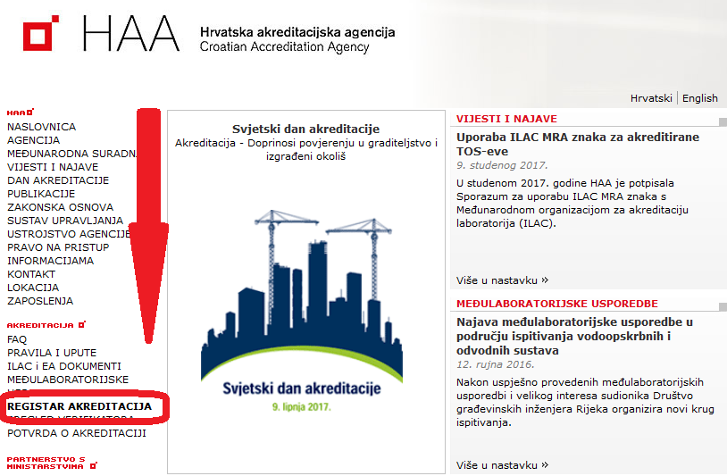
11.7 CAA’s role in planning and implementation of inspection
European Union IPA 2013 Programme for Croatia
ACCREDITATION
Institut za energetiku i zaštitu okoliša
Energy Research and Environmental Protection Institute

Slide 22
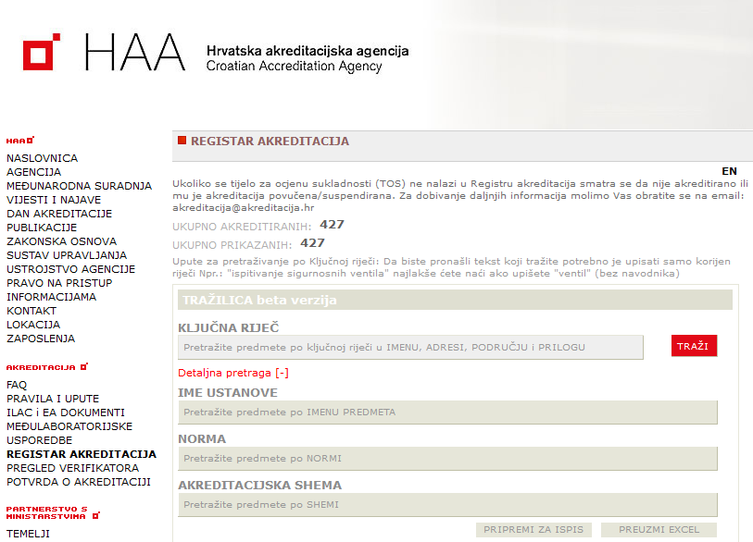
11.7 CAA’s role in planning and implementation of inspection
European Union IPA 2013 Programme for Croatia
ACCREDITATION
Institut za energetiku i zaštitu okoliša
Energy Research and Environmental Protection Institute

Slide 23
11.7 CAA’s role in planning and implementation of inspection
European Union IPA 2013 Programme for Croatia
INSPECTION
The CAA carries out inspection over the accredited bodies in order to ensure constant compliance with the prescribed requirements for performing the tasks for which accreditation has been granted.
The condition for maintaining the accreditation certificate is the permanent and full compliance with the accreditation criteria.
Inspection is carried out throughout the entire inspection period from the date of issue of the accreditation certificate until the expiry date of its validity (5 years).
The CAA distinguishes between two types of inspection reviews:
- regular inspection reviews and
- special inspection.
Institut za energetiku i zaštitu okoliša
Energy Research and Environmental Protection Institute

Slide 24
11.7 CAA’s role in planning and implementation of inspection
European Union IPA 2013 Programme for Croatia
INSPECTION
The accreditation area may be changed during the validation of the accreditation certificate:
- narrow down
- expand.
As part of inspection reviews, or irrespective of them, competent authorities can expand, narrow down or otherwise change the accreditation area (e.g., adopt a new issue of test standard).
The accreditation area is defined in the Attachment of the Accreditation Certificate, which clearly indicates what the body is qualified for (e.g., specific test methods).
Institut za energetiku i zaštitu okoliša
Energy Research and Environmental Protection Institute

Slide 25
11.7 CAA’s role in planning and implementation of inspection
European Union IPA 2013 Programme for Croatia
EXAMPLE: LABORATORY EVALUATION
Evaluation is conducted by a group of evaluators consisting of qualified lead evaluator and one or more evaluators and / or experts.
Evaluation of a testing laboratory is carried out in accordance with the requirements of HRN EN ISO / IEC 17025.
The lead evaluator usually evaluates the laboratory management system and the evaluators assess technical requirements and test methods.
The experts evaluate the application of the test method.
Institut za energetiku i zaštitu okoliša
Energy Research and Environmental Protection Institute

Slide 26
11.7 CAA’s role in planning and implementation of inspection
European Union IPA 2013 Programme for Croatia
EXAMPLE: LABORATORY EVALUATION
The lead evaluator evaluates according to HRN EN ISO / IEC 17025 following:
laboratory organization
laboratory management system
managing documents and records
Contracting, subcontracting and supply
feedback and complaints
managing non-compliance
improvements, corrective and preventive actions
internal audit
management review (administrative assessment)
Institut za energetiku i zaštitu okoliša
Energy Research and Environmental Protection Institute

Slide 27
11.7 CAA’s role in planning and implementation of inspection
European Union IPA 2013 Programme for Croatia
EXAMPLE: LABORATORY EVALUATION
Technical evaluator evaluates according to HRN EN ISO / IEC 17025 following:
STAFF
- if a laboratory has trained staff
- how qualifications are reflected
- proof of qualification
- which are the authorizations, responsibilities and tasks of staff
- how to handle all necessary records
- how the needs for training are determined and how the training is carried out
- how to evaluate staff training ...
Institut za energetiku i zaštitu okoliša
Energy Research and Environmental Protection Institute

Slide 28
11.7 CAA’s role in planning and implementation of inspection
European Union IPA 2013 Programme for Croatia
EXAMPLE: LABORATORY EVALUATION
Technical evaluator evaluates according to HRN EN ISO / IEC 17025 following:
ACCOMMODATION AND ENVIRONMENTAL CONDITIONS
- if a laboratory has the required infrastructure?
- if a laboratory conducts its activities in satisfactory conditions
- whether environmental conditions are being recorded
- if an account is taken that there are no disruptions that will lead to doubt the validity of the test results ...
Institut za energetiku i zaštitu okoliša
Energy Research and Environmental Protection Institute

Slide 29
11.7 CAA’s role in planning and implementation of inspection
European Union IPA 2013 Programme for Croatia
EXAMPLE: LABORATORY EVALUATION
Technical evaluator evaluates according to HRN EN ISO / IEC 17025 following:
METHODS OF EXAMINATION
- whether the tests are conducted in accordance with the testing standards
- whether the changes in test standards are being followed and whether they are adhered to
- whether all the criteria that the test standards require are met
- verification of the implementation of the testing method through the demonstration:
- field testing
- verification of lab testing
- verification of records and reports
- verification of budget and results reporting ...
Institut za energetiku i zaštitu okoliša
Energy Research and Environmental Protection Institute

Slide 30
11.7 CAA’s role in planning and implementation of inspection
European Union IPA 2013 Programme for Croatia
EXAMPLE: LABORATORY EVALUATION
Technical evaluator evaluates according to HRN EN ISO / IEC 17025 following:
EQUIPMENT
- whether a laboratory has all necessary equipment?
- whether the equipment meets the required criteria
- if the equipment records are kept
- whether the equipment is maintained
- whether the equipment is calibrated
- whether the equipment is unambiguously labelled
- whether its calibration condition is marked
- which equipment is used to carry out which tests
- how defective equipment is dealt with…
Institut za energetiku i zaštitu okoliša
Energy Research and Environmental Protection Institute

Slide 31
11.7 CAA’s role in planning and implementation of inspection
European Union IPA 2013 Programme for Croatia
EXAMPLE: LABORATORY EVALUATION
Technical evaluator evaluates according to HRN EN ISO / IEC 17025 following:
MEASURE TRACEABILITY
- whether the equipment is metrologically traceable
- if there is a calibration program
- whether the calibration frequency is satisfactory
- whether the equipment is maintained
- whether the equipment is calibrated
- whether the calibration certificate is traceable (issued by an accredited calibration laboratory)
- how to deal with reference standards and materials ...
Institut za energetiku i zaštitu okoliša
Energy Research and Environmental Protection Institute

Slide 32
11.7 CAA’s role in planning and implementation of inspection
European Union IPA 2013 Programme for Croatia
EXAMPLE: LABORATORY EVALUATION
Technical evaluator evaluates according to HRN EN ISO / IEC 17025 following:
HANDLING WITH TESTING SUBJECTS
- how objects to be tested are handled
- whether it is ensured that traceability does not result in mixing or confusion
- whether objects are handled correctly to get the right information during testing ...
Institut za energetiku i zaštitu okoliša
Energy Research and Environmental Protection Institute

Slide 33
11.7 CAA’s role in planning and implementation of inspection
European Union IPA 2013 Programme for Croatia
EXAMPLE: LABORATORY EVALUATION
Technical evaluator evaluates according to HRN EN ISO / IEC 17025 following:
QUALITY ASSURANCE OF RESULTS
- whether internal quality control measures are being implemented
- what are the results of the internal quality
- what is being done in case of bad results
- whether the laboratory participates in interlaboratory comparisons and capability testing
- which is the frequency of participation
- whether the results of the participation are evaluated
- how to use quality assurance results in laboratory work ...
Institut za energetiku i zaštitu okoliša
Energy Research and Environmental Protection Institute

Slide 34
11.7 CAA’s role in planning and implementation of inspection
European Union IPA 2013 Programme for Croatia
EXAMPLE: LABORATORY EVALUATION
Technical evaluator evaluates according to HRN EN ISO / IEC 17025 following:
RESULTS PRESENTATION
- whether test reports contain all necessary information
- whether calculations are correct
- whether there is traceability from raw data to reports
- whether test methods and possible deviations are precisely stated
- whether a report contains all relevant information specified by the test standard
- who makes and who approves reports
- how reports are delivered to the buyer
- how to deal with reporting errors ...
Institut za energetiku i zaštitu okoliša
Energy Research and Environmental Protection Institute

Slide 35
11.7 CAA’s role in planning and implementation of inspection
European Union IPA 2013 Programme for Croatia
ACCREDITATION CERTIFICATE
Institut za energetiku i zaštitu okoliša
Energy Research and Environmental Protection Institute

Slide 36
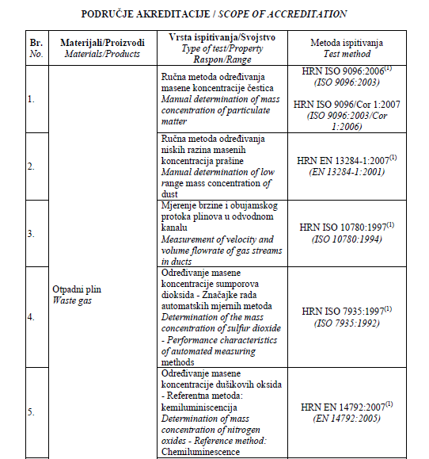
11.7 CAA’s role in planning and implementation of inspection
European Union IPA 2013 Programme for Croatia
APPENDIX TO ACCREDITATION
CERTIFICATE
Institut za energetiku i zaštitu okoliša
Energy Research and Environmental Protection Institute

Slide 37
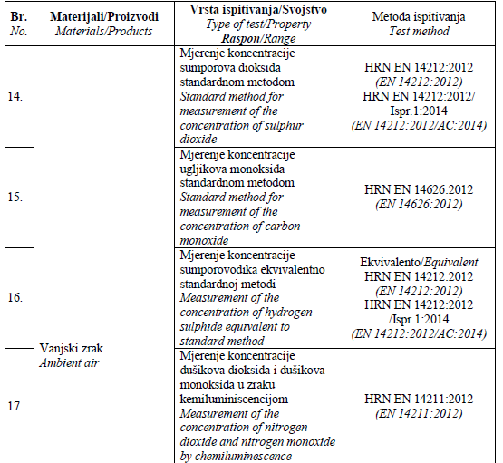
11.7 CAA’s role in planning and implementation of inspection
European Union IPA 2013 Programme for Croatia
APPENDIX TO ACCREDITATION
CERTIFICATE
Institut za energetiku i zaštitu okoliša
Energy Research and Environmental Protection Institute

Slide 38
THANK YOU FOR YOUR ATTENTION
Energy Research and Environmental Protection Institute
Disclaimer: The contents of this publication are the sole responsibility of EKONERG – Energy Research and Environmental Protection Institute, Ltd. and can in no way be taken to reflect the views of the European Union
This project is funded by the European Union

